Slide 1
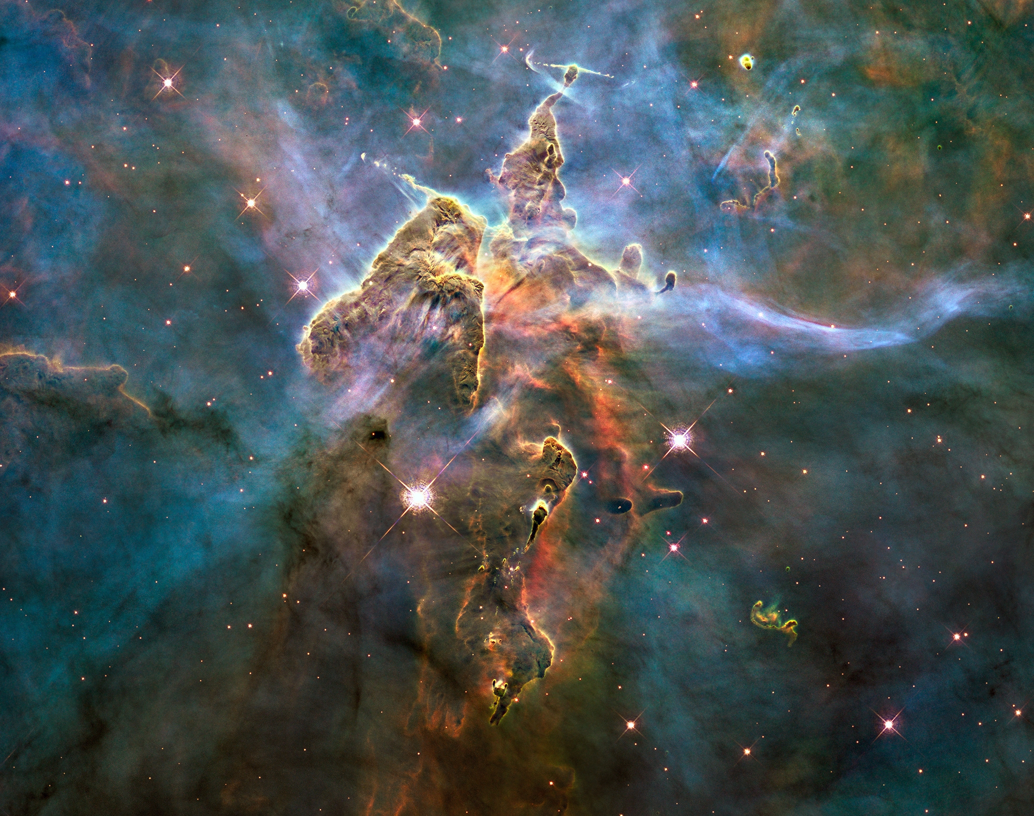
Big Bang Meals
By Ian Troop, Dylan Renninger, Akira Misselhorn
This Photo by Unknown author is licensed under CC BY-SA.
Notes:
All/Akira

Slide 2
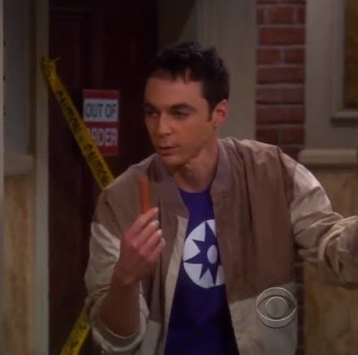
Intro
Background
  Big Bang Theory
  Sheldon’s Spaghetti Catalyst
  E20S3 “The Spaghetti Catalyst”
Overview
  Product Spec
  Project Timeline
  Current Process
  Data Collection
  Process Capability
  Fishbone
  Proposed Solutions
  Defect Cost
  Projected Savings
Notes:
Akira
At Big Bang Meals, we make a variety of meals. One of which involves our process of cutting hotdogs into smaller bite sized pieces. This presentation will cover our planning, process, and potential as a company. The meal these hotdogs are a part of is called "Sheldon's Special".

Slide 3
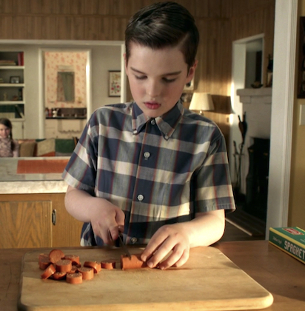
Product Specifications
Sheldon's Spaghetti Catalyst by Big Bang Meals contains spaghetti, marinara sauce, and 1 hotdog cut into 11 slices
Each slice should be 1cm in length and weigh 4.0g.
Tolerance of ±0.5g.
Notes:
Akira
Mirrored Sheldon’s want for consistency and accuracy, hence the tight specification.

Slide 4
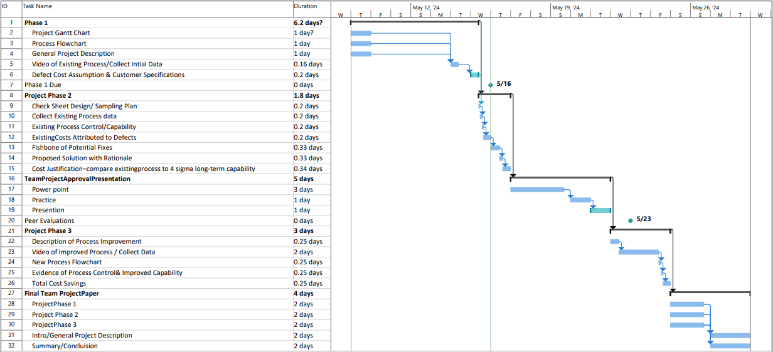
Gantt Chart
Notes:
Ian

Slide 5
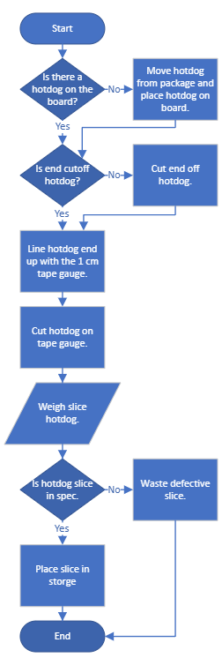
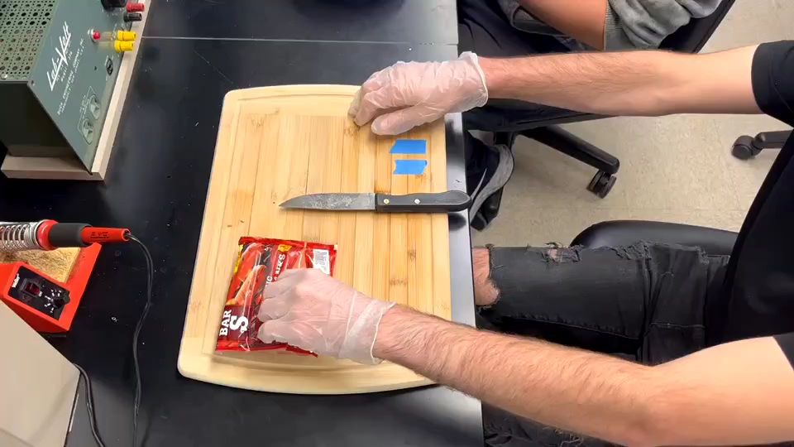
Process
Notes:
Ian

Slide 6
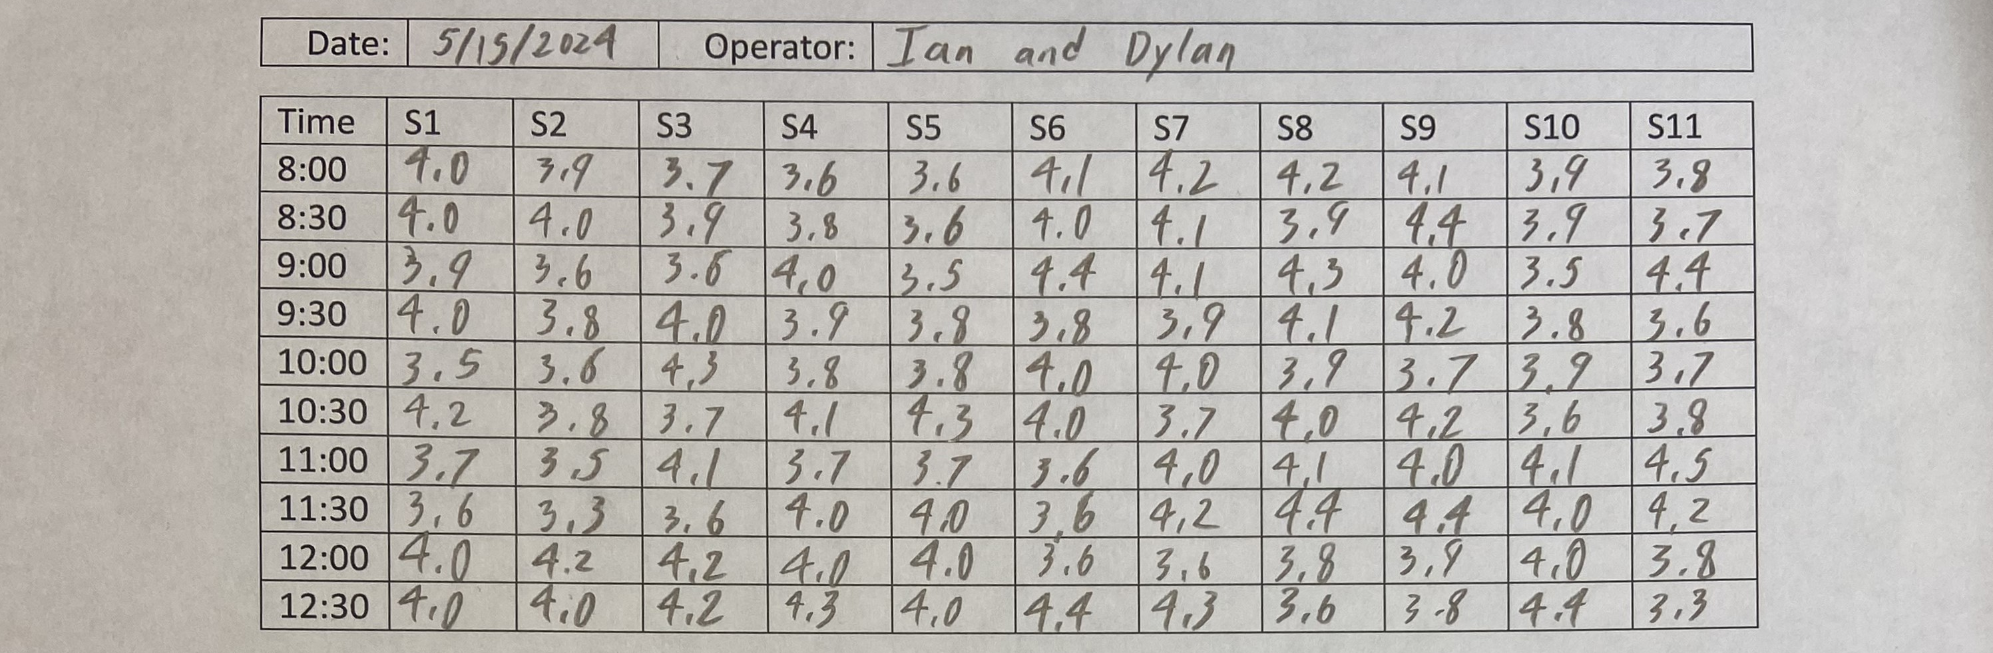
Check Sheet
n = 11
k = 10
N = k x n = 110
Targets
  Length = 1 cm
  Weight = 4.0 g
Notes:
Akira
Big N = 110
Little n represents the number of slices our hot dog is cut up into with our k representing number of hot dogs.

Slide 7
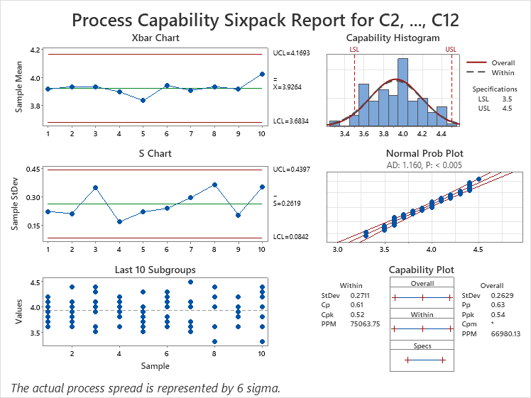
Process Control Capability (6 pack)
The histogram appears to fit a bell curve.
Data in the Xbar and S chart does not appear to exceed the control limits.
Data appears random.
The processes appears to be capable with a CPK of 0.52.
The data appears centered since the CP and CPK are close to equal.
Notes:
Dylan
1 sigma is 0.33
2 sigma is 0.67

Slide 8
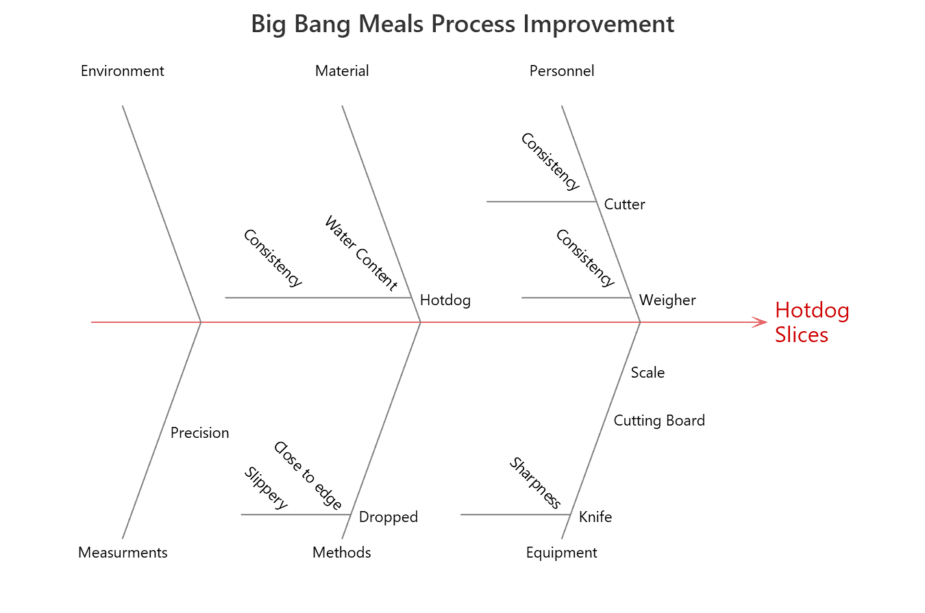
Fishbone
Notes:
Ian
Brainstorming led us to find these issues to be the most problematic and defect-causing

Slide 9
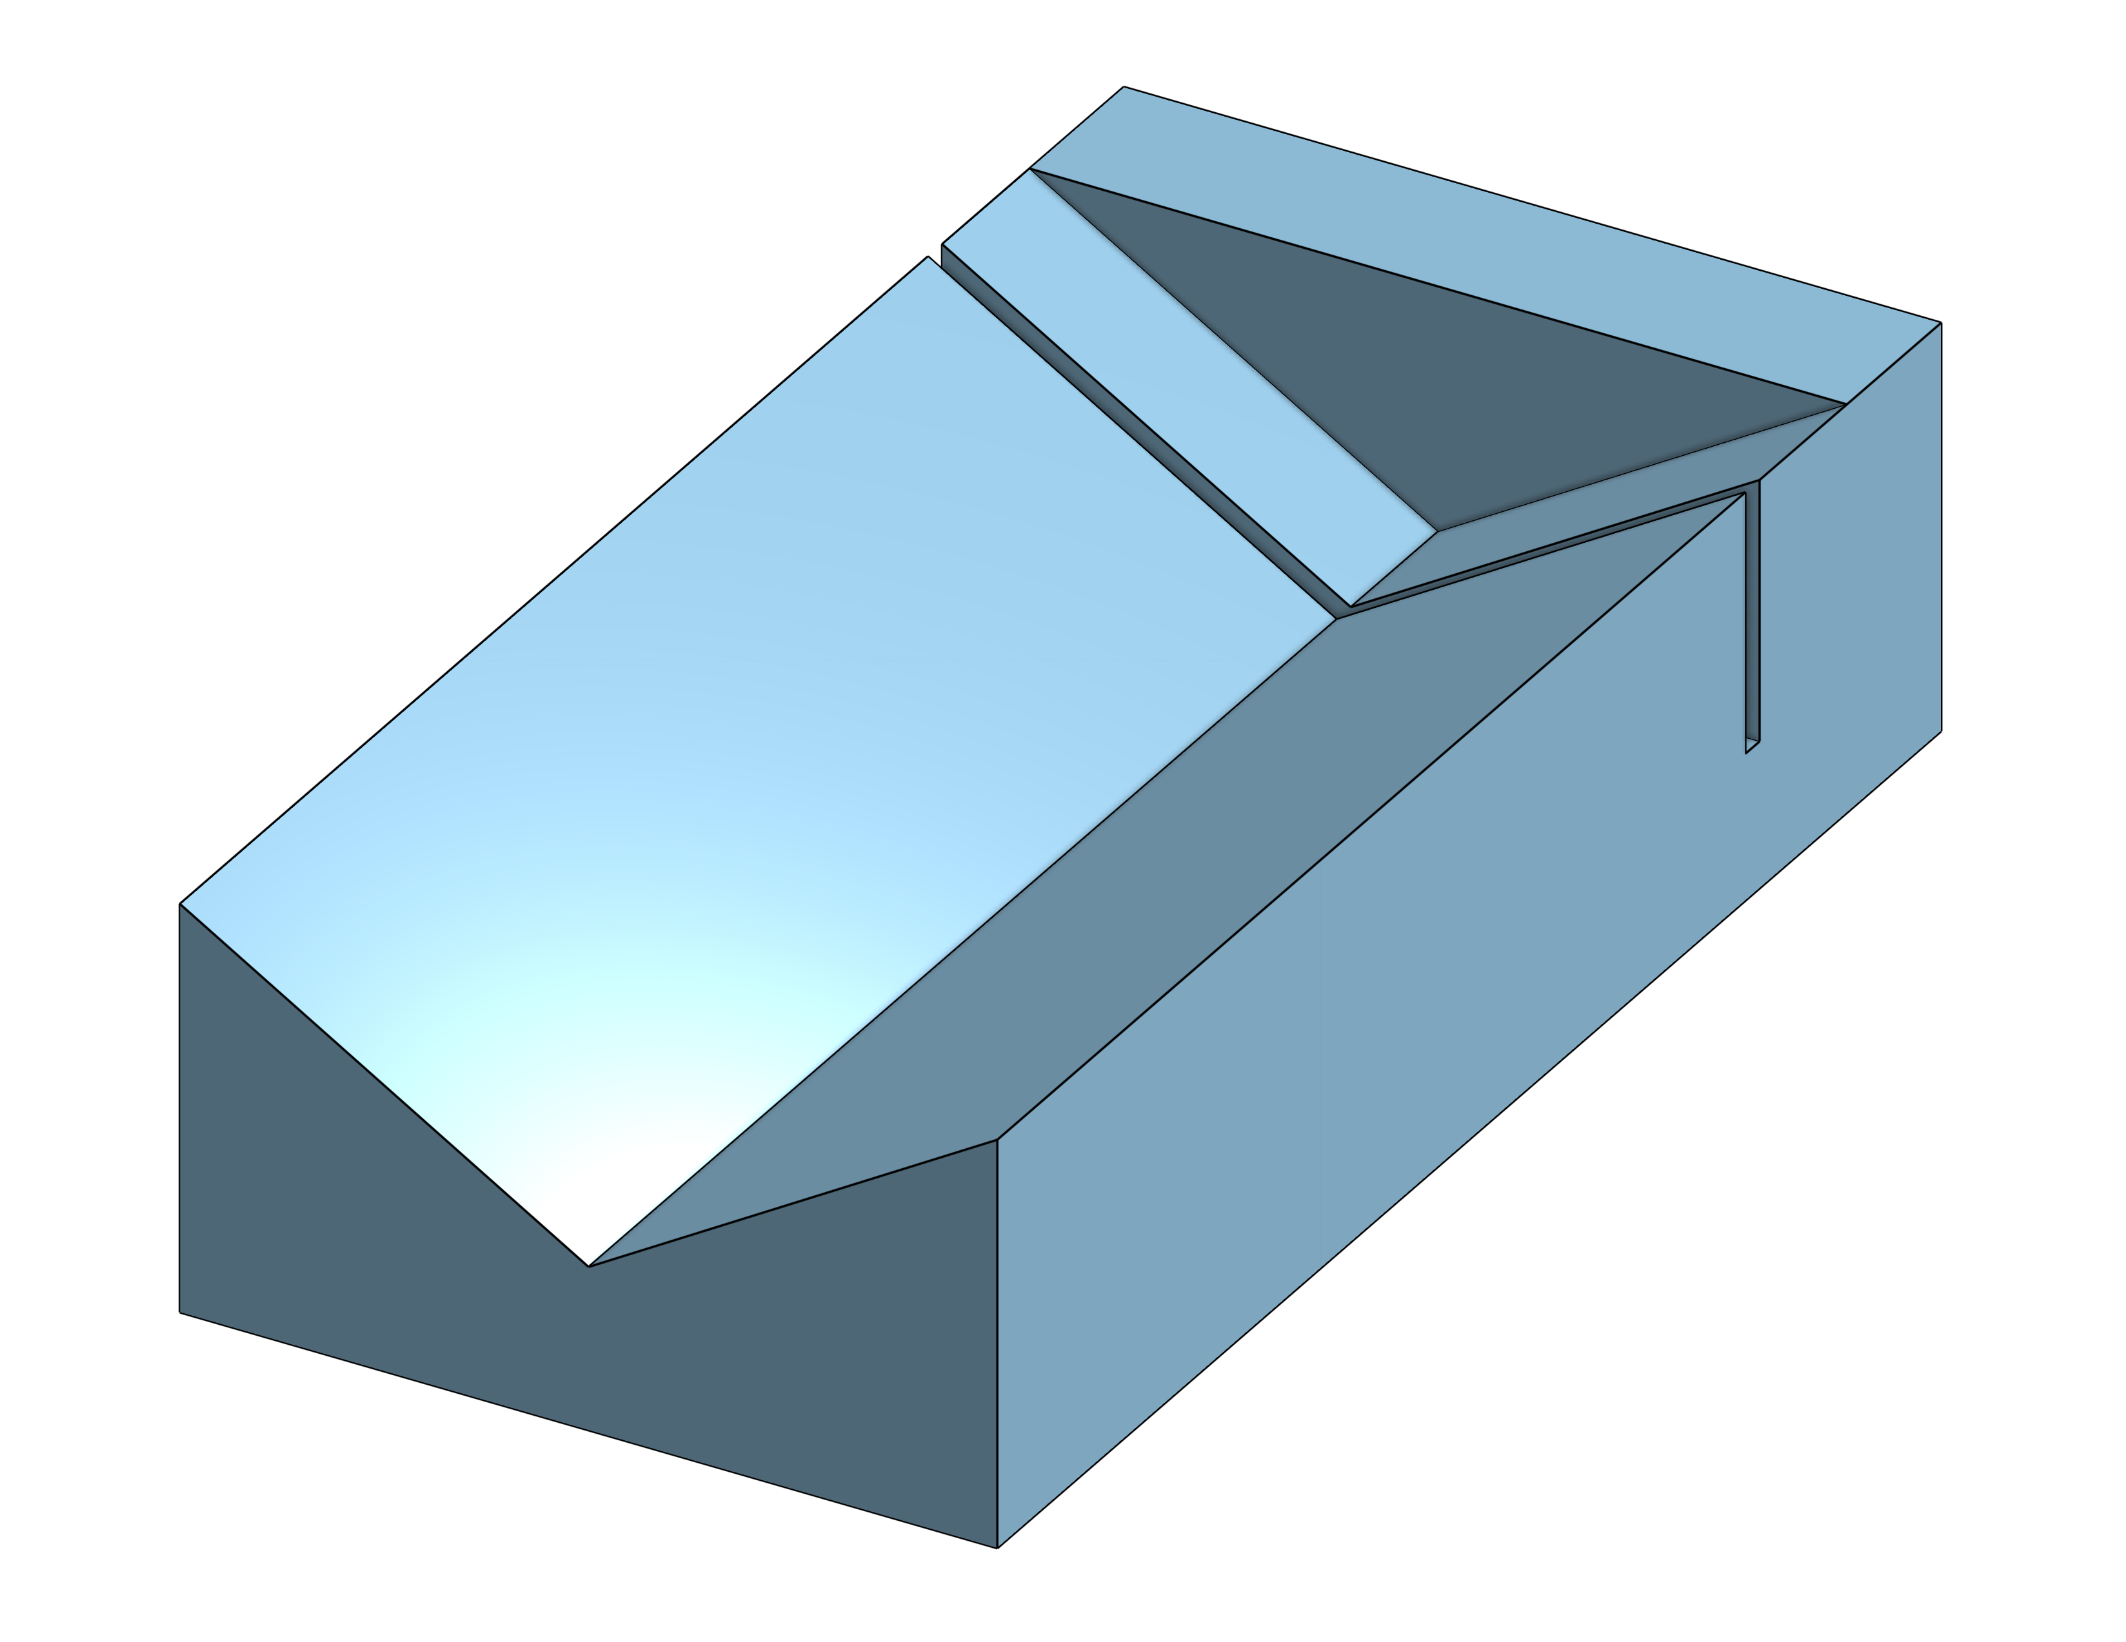
Proposed Solution
Operator consensus
  Operator placement precision
  Knife sharpness
Proposed Solutions
  Cutting jig: $5
  Knife sharpener: $40
Notes:
Ian
Following the fish bone operator consensus appeared to indicate that the operator's ability to place the hot dog and knife as precisely as the spec required was the root of most defects. With this information the engineering team is proposing a 3D printed jig as shown in the preliminary sketch on the right.

Slide 10
Defect Cost Assumption
DCA = (Material + Time) x 1.25
Material Cost = $5.00/10 hotdogs= $0.50/hotdog ÷ 11 slices = $0.05/slice
$20/hr x 2 ÷ 60min/hr = $0.67/min ÷ 60 sec/min = $0.01/sec
Time = $0.01/sec x 97sec/hotdog = $0.97/hotdog ÷11 slices/hotdog = $0.09/slice
DCA = ($0.05/slice + $0.09/slice) x 1.25 = $0.18/slice
Notes:
Dylan
Length of Process at 97 sec
1.25 = Overhead costs = Additional costs not included in the expenses for the process
Operator pay the converted to money made per second.
Hotdog price per dog

Slide 11
Defect Cost Per Year
Work Time/yr = 40 hrs/week x 50 wks/yr x 0.85* = 1700 hrs/yr x 60 mins/hr = 102,000 mins/yr x 60 sec/min = 6,120,000 sec/yr
Defects/yr = 6,120,000 sec/yr ÷ 9sec = 680,000 prod/yr x .54** = 367,200 def/yr
Cost/yr = 367,200 def/yr x $0.18/slice = $66,096/yr
*Labor Utilization Rate = 85%
**Current Defect Rate = 54%
Notes:
Dylan
We will discuss how we got the .54 number from the yield conversion chart.

Slide 12
Projected Savings
Projected Process Yield(4 Sigma)
680,000 units/yr x 0.006 = 4080 def/yr
4080 def/yr x 0.18 cost/def = $734.40 cost/yr
$66,096 – $734.40 = $65,361.60 saved!
Notes:
Dylan

